Slide 1
COSI 126
Final Presentation
Zihao Wang, Jie Tang, Han Yue, Kun Li

Slide 2
Table of Contents
What is this paper
Define the problem
Paper’s model
Our model
Conclusion

Slide 3
What is this paper?
Name: Return of Frustratingly Easy Domain Adaptation
Authors: Baochen Sun, Jiashi Feng, Kate Saenko
Published Conference: AAAI-16
Key words: Domain adaptation, unsupervised learning

Slide 4
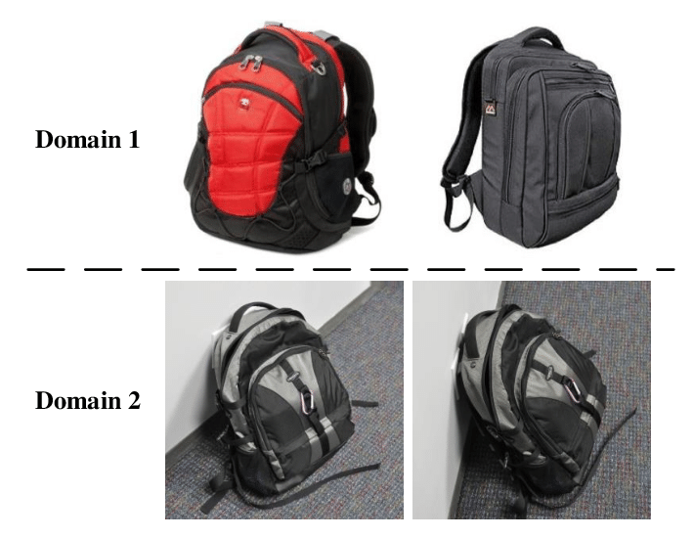
Basic Terms
Domain Shift: Source data distribution is different than Target data distribution.
Source domain: training data distribution.
Target domain: testing data distribution.
Notes:
Example for domain shift. The bags from domain 1 do not have any background while those from domain 2 have complex background. The classifier trained on one domain will suffer from performance degradation when it is tested on the other domain

Slide 5
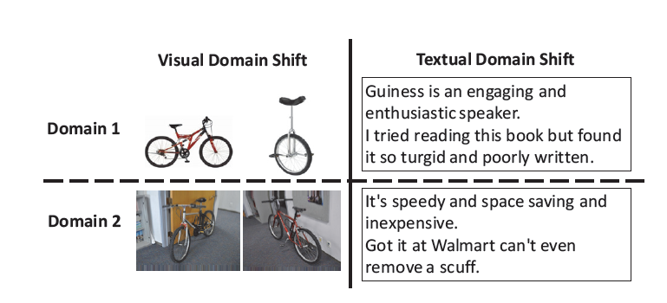
Domain Shift Scenarios
Object recognition
Sentiment prediction
Notes:
Two Domain Shift Scenarios: object recognition
across visual domains (left)， the data points distribution are different, since they have very different background
sentiment prediction across text domains (right),
When data distributions differ across to another domain is likely to cause a significantly drop of performance
domains, applying classifiers trained on one domain directly drop.

Slide 6
Problem Definition
In this paper, it discusses an efficient method for unsupervised domain adaptation that minimizes domain shift.

Slide 7
Challenges
Target domains are unlabeled
Expensive subspace projection and hyperparameter selection
Loss-layer approach
Notes:
During machine learning experiments, there are many scenarios where the target domain is unlabeled thus requiring unsupervised domain adaptation.
Early techniques for unsupervised adaptation only align the bases of the subspaces, not the distribution of the projected points. They also require expensive subspace projection and hyperparameter selection.
Current approaches are limited to two adaptation layers and additional layers can be costly and sensitive to initialization, network structure, and other optimization settings.

Slide 8
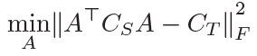

Paper’s solution
Apply linear transformation A to original source features to minimize the distance between the second-order statistics.
A = U_{S}E =
Whitens the source data
Re-colors it with target covariance
Notes:
covariance of the transformed source features
Ct is covariance of the target feature
align covariance across domains
Covariance is between features in each domain
A is optimal solution to the objective function
Whitens: removing the feature correlation of source domain
Recolor: adding the correlation of target domain to the source features

Slide 9
Reimplementation Result
 | A → C | A → D | A → W | C → A | C → D | C → W | D → A | D → C | D → W | W → A | W → C | W → D | AVG
Paper Result | 45.1 | 39.5 | 44.4 | 52.1 | 45.9 | 46.4 | 37.7 | 33.8 | 84.7 | 36.0 | 33.7 | 86.6 | 48.8
Reimplementation | 42.5 | 40.1 | 34.2 | 53.2 | 45.8 | 37.9 | 32.2 | 29.2 | 82.8 | 31.1 | 30.5 | 85.4 | 45.4
12 domain shifts on the Office-Caltech10 dataset (Gong et al. 2012) with SURF features, using the “full training” protocol.
Notes:
speeded up robust features (SURF) is a patented local feature detector and descriptor.
Matlab code with Svm convert into python,

Slide 10
Reimplementation Result
 | A --> W | A --> D | D --> A | D --> W | W -->A | W --> D | AVG
Paper Result | 61.9 | 62.2 | 48.8 | 96.2 | 48.2 | 99.5 | 69.4
Reimplementation | 65.7 | 64.3 | 48.5 | 96.1 | 48.2 | 99.8 | 70.4
6 domain shifts on the Office-Caltech10 dataset (Gong et al. 2012) with deep features, using the “full training” protocol.
Notes:
speeded up robust features (SURF) is a patented local feature detector and descriptor.
Matlab code with Svm convert into python,

Slide 11
Comments
Advantages
1) Easy to understand and implement
2) High performance on multiple features types and tasks [deep features, CV, NLP]
Disadvantages
1) No high improvement on SURF features (46.7%)
2) This is not a joint model
3) Linear transformation may not be a good choice for some datasets
Notes:
Four lines of code
Shallow features is not as high as deep features
Not guaranteed

Slide 12
Our ideas
Do deep learning on transformation process
Instead of using A to transform S → S’, we can try a deep learning method to learn nonlinear transformation
Try different distance for correlation alignment
The alignment of CORAL is projected in the Euclidean space, which may not be the best choice for some datasets
Use ensemble methods for classification
Majority voting
Tune hyperparameters

Slide 13
Deep method structure
ResNet-18
source prediction
soure
classification loss
target
target prediction
alignment loss

Slide 14
Our result on deep method
 | A --> W | A --> D | D --> A | D --> W | W -->A | W --> D | AVG
Paper Result | 61.9 | 62.2 | 48.8 | 96.2 | 48.2 | 99.5 | 69.4
Our Model | 70.2 | 66.06 | 58.8 | 93.2 | 56.7 | 89.0 | 72.3
6 domain shifts on the Office-Caltech10 dataset (Gong et al. 2012), using the “full training” protocol.

Slide 15
Conclusion
Advantages
Higher improvement on deep features
Disadvantages
Expensive calculation

Slide 16
Thank you

